Slide 1
PROJECT TITLE: KEYLOGGER AND SECURITY
Presented By: Ramprasath M K
College: Anjalai Ammal Mahalingam Engineering College
Department: Information Technology

Slide 2
WHAT IS KEYLOGGER?
A keylogger (or keystroke logger) is a type of spyware that monitors and records what you type on your computer or mobile phone. Keylogging software or hardware can be used to monitor activity for legal or illegal purposes.

Slide 3
HOW KEYLOGGER WORKS?
Keyloggers work by recording the interactions a user has with their keyboard, allowing someone to access a log of every email, instant message, search query, password, username, or other keyed sequences that a user types.

Slide 4
Keylogging malware can infect your computer through many of the same mechanisms as other common viruses, but keyloggers can also be intentionally purchased and downloaded.

Slide 5
OUTLINE:
Problem Statement
Proposed Solution
Algorithms Used
Output
Conclusion

Slide 6
PROBLEM STATEMENT
Keyloggers are programs or devices that secretly record everything a person types on their computer keyboard. This poses a significant risk as it can capture sensitive information like passwords, credit card numbers, and personal messages without the user's knowledge. Preventing keyloggers is crucial to protect user privacy and prevent unauthorized access to sensitive data.

Slide 7
PROPOSED SOLUTION
Antivirus and Anti-malware Software: Implement robust antivirus and anti-malware software that can detect and remove keyloggers from the system.
Regular Software Updates: Ensure that operating systems and applications are regularly updated with the latest security patches to fix vulnerabilities that could be exploited by keyloggers.
Security Awareness Training: Educate users about the risks of keyloggers and how to recognize and avoid phishing attacks and malicious websites that may distribute keylogger software.
Use of Virtual Keyboards: Encourage the use of virtual keyboards for entering sensitive information like passwords, as these are immune to keyloggers that capture physical keyboard input.

Slide 8
Behavioral Monitoring: Employ behavioral monitoring tools to detect unusual patterns of activity that may indicate the presence of a keylogger on the system.
Network Security Measures: Implement firewalls and network monitoring tools to prevent keyloggers from transmitting captured data to remote servers controlled by attackers.
Encryption: Utilize encryption for sensitive data transmission and storage to make it more difficult for keyloggers to capture usable information.
Regular Security Audits: Conduct regular security audits to identify and address any vulnerabilities in systems and networks that could be exploited by keyloggers or other malware.

Slide 9
ALGORITHMS USED
1. Anomaly Detection: Anomaly detection algorithms can monitor user behavior and system activities to identify unusual patterns that may indicate the presence of a keylogger. These algorithms often utilize machine learning techniques to establish normal behavior baselines and detect deviations from it.
2. Heuristic Analysis: Heuristic analysis algorithms are used by antivirus and anti-malware software to identify suspicious behavior patterns associated with keyloggers. By analyzing the behavior of programs and processes in real-time, these algorithms can detect and block keylogger activities.
3. Secure Input Transmission: Algorithms for secure input transmission encrypt keystrokes before they are transmitted from the keyboard to the operating system. This prevents keyloggers from intercepting sensitive keystrokes in transit.

Slide 10
4. Kernel-Level Protection: Some security solutions implement algorithms at the kernel level to protect against keyloggers. These algorithms monitor system calls and processes at a low level to detect and prevent unauthorized access to keyboard input.
5. Biometric Authentication: Biometric authentication methods such as fingerprint scanners or facial recognition can prevent keyloggers from capturing login credentials since they rely on unique biological traits rather than typed passwords.
6. Secure Password Managers: Password managers utilize encryption algorithms to store and manage passwords securely. By auto filling login credentials, they prevent users from typing passwords directly into potentially compromised environments where keyloggers may be present.

Slide 11
REQUIREMENTS INSTALLATION FOR EXECUTION OF KEYLOGGER
The ‘requirements.txt’ file:
pynput
Jsonlib
Install ‘requirements.txt’ file:
pip install -r requirements.txt

Slide 12

OUTPUT

Slide 13
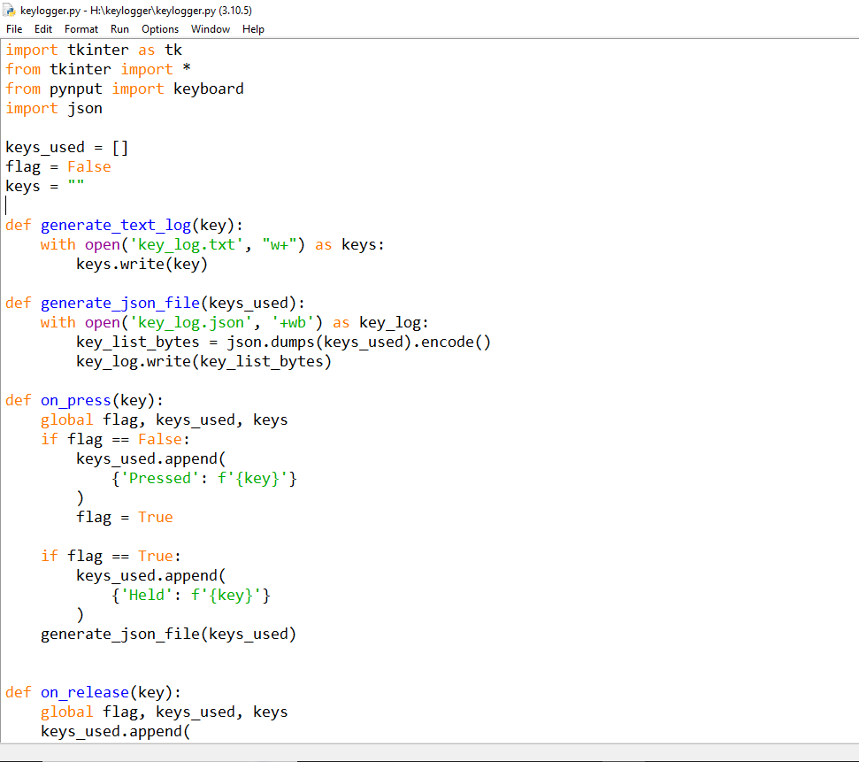

Slide 14


Slide 15


Slide 16
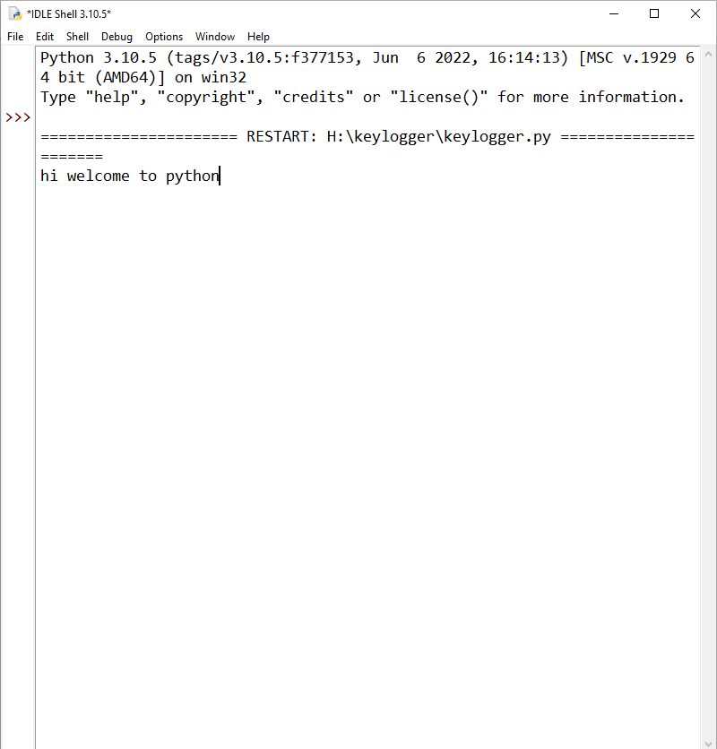

Slide 17


Slide 18


Slide 19
CONCLUSION
By implementing antivirus software, regularly updating systems, educating users, utilizing virtual keyboards, monitoring for suspicious activity, strengthening network security, employing encryption, and conducting regular security audits, we can significantly reduce the risk of keyloggers compromising sensitive information.
These measures help protect user privacy and safeguard against unauthorized access to personal and confidential data, enhancing overall cybersecurity posture.

